Slide 1
Developing microhaplotypes: data generation and filtering
Kerry Reid, Diana Baetscher, Thomas Ng, Anthony Clemento, Cassie Columbus, Ellen Campbell, Laney Correa, Eric Anderson, Carlos Garza

Slide 2
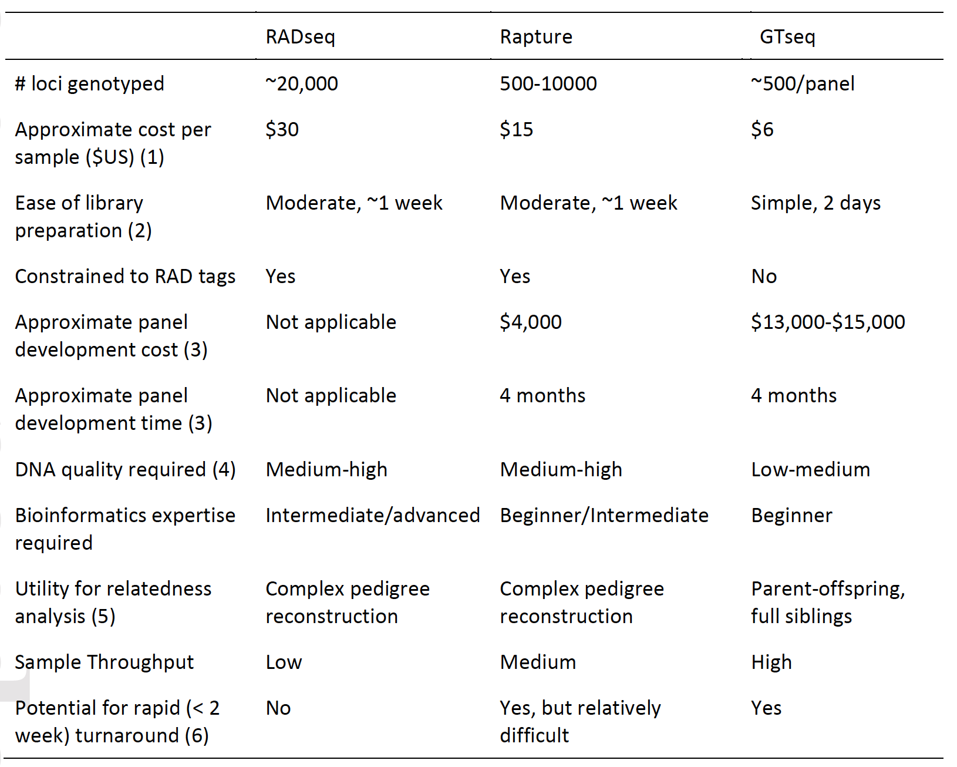
Study Design
When is it appropriate to use microhaps and GT-seq?
When you have thousands of samples
Target loci in the hundreds
Require high quality data
Will continue monitoring through time
Don’t have access to advanced bioinformatics skills
Meek & Larson 2019

Slide 3
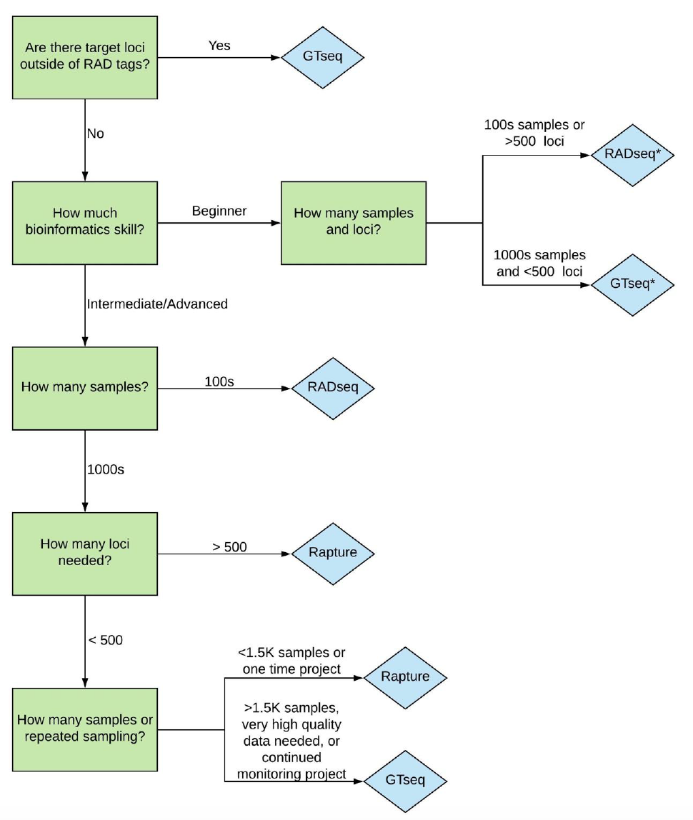
Study Design
How many samples can be run in a single library?
dependent on:
read depth per locus
number of loci
Meek & Larson 2019

Slide 4
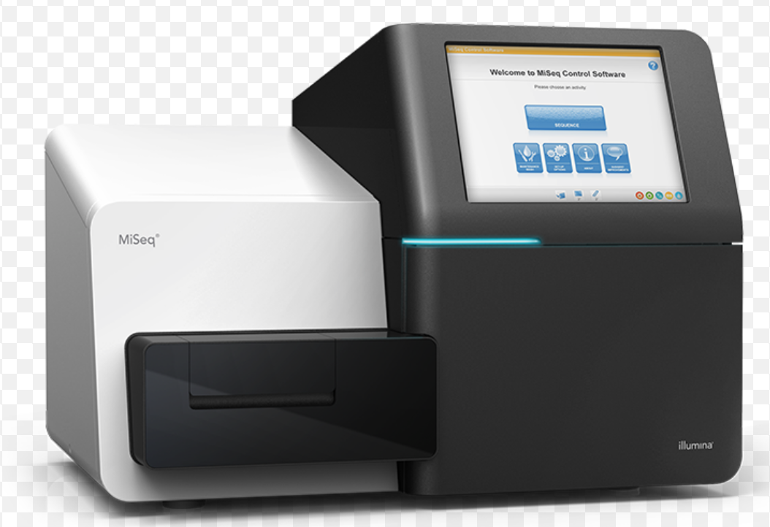
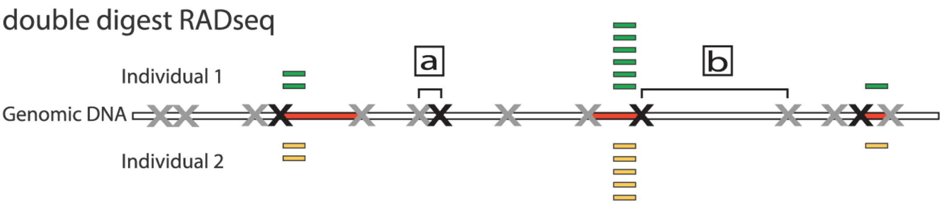
Microhaplotype development and analysis workflow
iterative
Identifying microhaplotypes
Multiplex targeted loci
e.g. ddRAD
e.g. with GT-seq
Merge reads (FLASH)
~20 – 25 mil reads per run
generate haplotypes
‘microhaplot’
Call Variants
(FREEBAYES)
Filter on read depth, minor allele frequency
Map (BWA-MEM) to references
Convert SAM/BAM

Slide 5
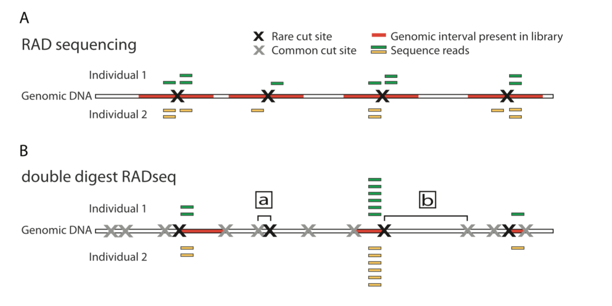
Identifying microhaplotypes
Reduced representation libraries (RADs)
Whole genome-seq
Expressed sequence tags
Peterson et al. 2012

Slide 6
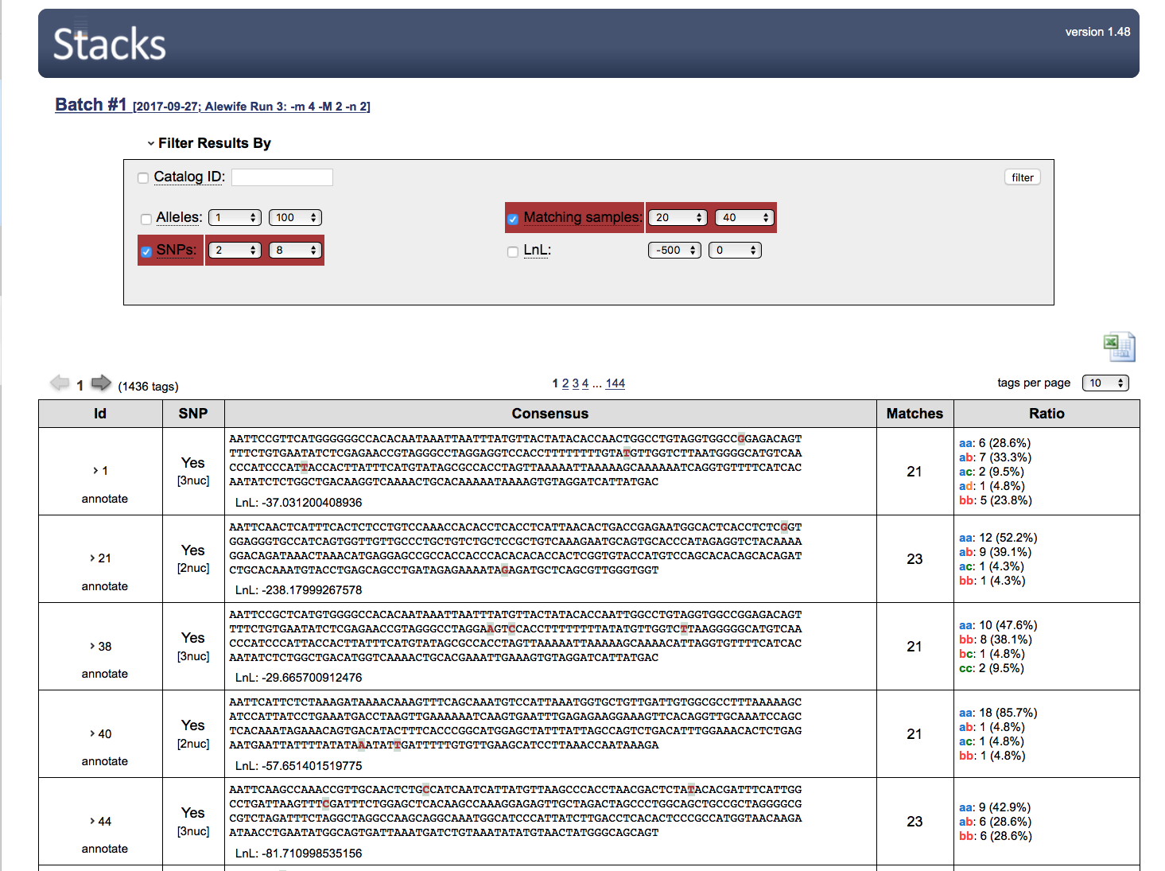
Examples: ddRAD

Slide 7
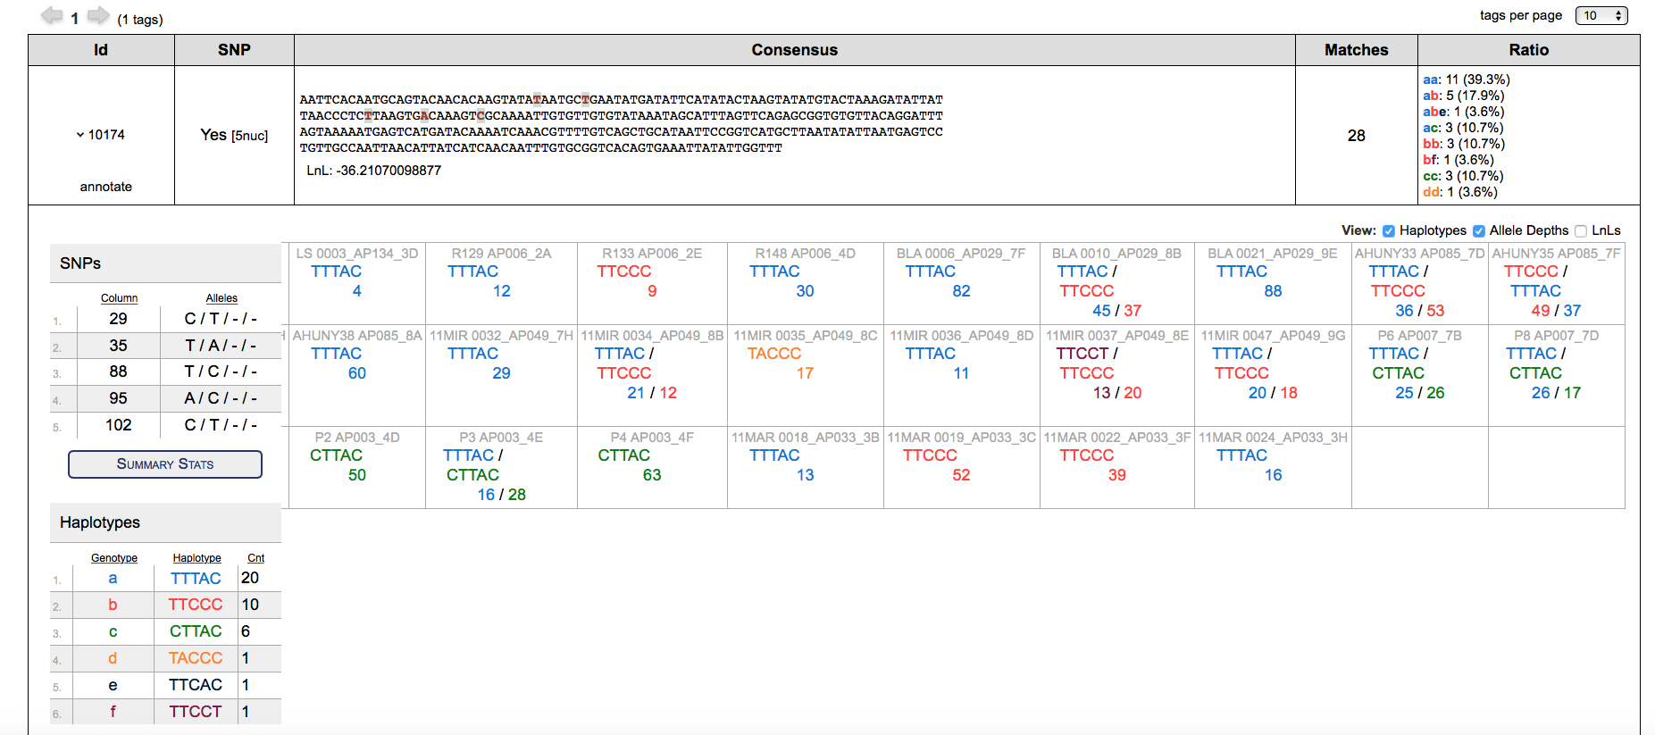
Examples: ddRAD
>tag_id_10174
TTCACAATGCAGTACAACACAAGTATATAATGCTGAATATGATATTCATATACTAAGTATATGTACTAAAGATATTATTAACCCTCTTAAGTGACAAAGTCGCAAAATTGTGTTGTGTATAAATAGCATTTAGTTCAGAGCGGTG: Fragment length 145

Slide 8
Selecting suitable loci
PCR fragment size (need to overlap for merging pair-end reads < 150 bp)
Number of SNPs (require more variation and multiple haplotypes compared to SNPs to provide more inference)
HWE (depending on question being addressed)
Not paralogous (depending of question being addressed)
NB – check for duplicates (BLAT, BLAST)

Slide 9
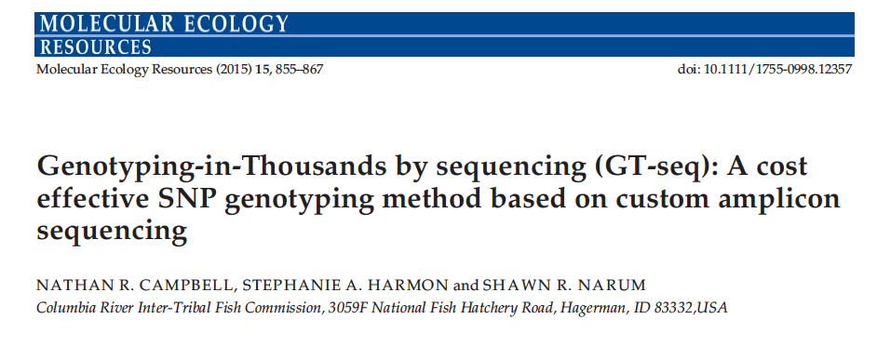
Amplicon design and GT-seq
We follow the Gtseq protocol of Campbell et al. 2015, we a few modifications indicated in Baetscher et al. 2017

Slide 10
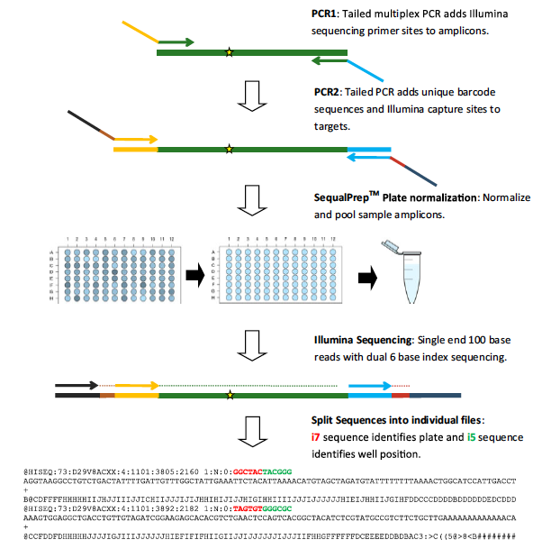
GT-seq: Lab
PCR1: target primers and illumina rna primers for sequencing
PCR2: plate specific and individuals barcodes
Modification: paired-end
Reason: Quality
Modification: instead of custom scripts we utilize standard NGS tools
Modified Campbell et al. 2015
Processing raw data

Slide 11
Panel optimization
Reads are distributed well across individuals and loci
Remove loci that don’t meet amplification criteria
Adjust panel through primer concentrations
Diluting or increasing primer concentrations

Slide 12

Data processing and analyses
Gtseq_example
flash
map
RDS_files
File Structure
raw
Datafiles_Mhaps_workshop_1
reference
Rproject_examplegtseq
variants

Slide 13
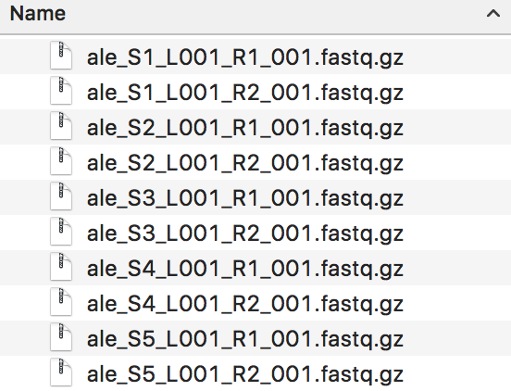
Raw data
raw
Illumina Miseq paired-end, 150 cycles
Read1 and Read2 per sample

Slide 14
Processing raw data: Merging reads
Merging Paired-end reads
View paired reads in folder raw
Change to flash cd ../flash
Run the following code using the program flash (FLASH v1.2.11) in an empty folder named flash to merge overlapping fragments
for i in {1..96}; do flash -m 3 -M 100 -z --output-prefix=ale_S${i} ../raw/*_S${i}_L001_R1_001.fastq.gz ../raw/*_S${i}_L001_R2_001.fastq.gz 2>>err >>out ; done
flash

Slide 15
Processing raw data: Mapping reads
To map reads to a reference we would like to do several things
Make a reference from the sequences from which we developed the loci
Map out flashed (merged) reads to these reference sequences
Convert these SAM files to BAM for utility with variant calling programs
Analyze how many reads mapped per locus for quality and adjustment of amplicon panel (GT-seq)

Slide 16
Preparing your reference file
index map
Use bwa
E.g bwa index -p alewife_final_cropped_117_loci -a is alewife_final_map_gtseq_cropped.fasta
http://bio-bwa.sourceforge.net for more information
I have indexed the reference and the associated files are in the reference folder

Slide 17
Mapping reads with BWA-MEM
Open sam_bam_gtseq_example.sh with a text editor e.g. text wrangler inside map folder
Here we loop through our individual flashed samples:
1. map our reads to the references using bwa-mem
2. convert sams to bams
3. index bams
4. generate idx stats
Gives us the locus name, fragment length, no of mapped reads
Open R project in
Rproject_examplegtseq

Slide 18
Mapping reads with BWA-MEM

Slide 19
Mapping reads with BWA-MEM

Slide 20
Mapping reads with BWA-MEM – example data

Slide 21
Mapping reads with BWA-MEM

Slide 22
Mapping reads with BWA-MEM

Slide 23
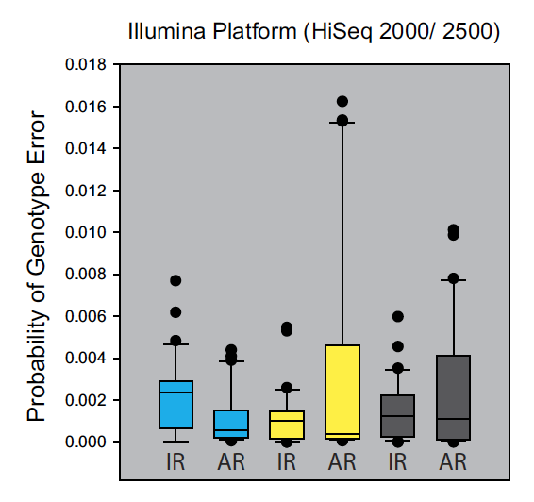
Variant calling - Freebayes
Need to re-index reference files using samtools
Samtools faidx
nohup freebayes-parallel <(fasta_generate_regions.py alewife_final_map_gtseq_cropped.fasta.fai 150) 10 -f alewife_final_map_gtseq_cropped.fasta -L bamlist.txt --haplotype-length 0 -kwVa --no-mnps --no-complex > alewife_gtseq12_noMNP_noComplex_noPriors.vcf
To account for all variants we merged several freebayes runs using the merge option to create the final vcf
We also filtered our vcf files
Hwang et al., 2015
freebayes
GATK
samtools

Slide 24
Microhaplot
Rproject_examplegtseq
R-package to maintain haplotypes
Requires
filtered vcf file
Sam files for each individual
Labels file associating sam file name with sample name and population
https://github.com/ngthomas/microhaplot
Follow instructions here to install and vignettes on how to use haplot

Slide 25
Microhaplot
microhaplot::mvShinyHaplot("~/Shiny")
run.label
vcf.path
label.path
app.path
haplo.read.tbl <- prepHaplotFiles(run.label = run.label,sam.path=sam.path,label.path=label.path,out.path = out.path,vcf.path=vcf.path,app.path=app.path)

Slide 26
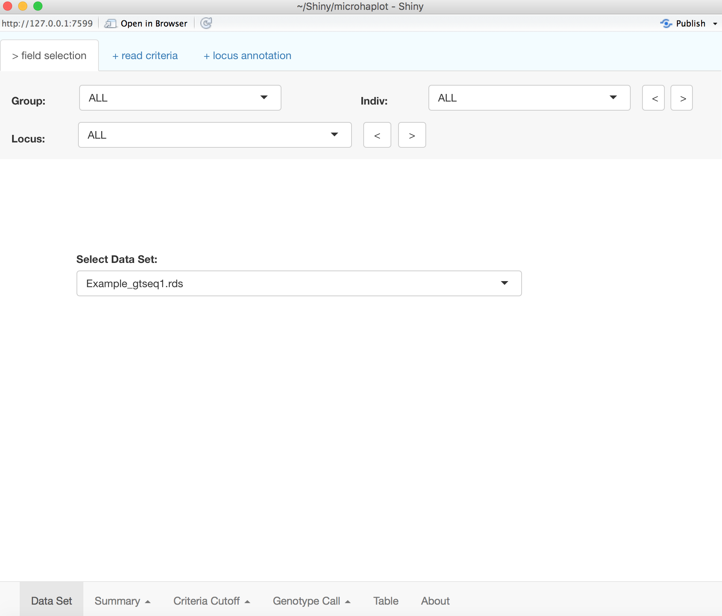
Microhaplot
Lets try out microhaplot
Continue in R-studio following the Rnotebook
Microhaplot will open a shiny app where we can visualize the amplicon data and filter on read depth and allelic ratio

Slide 27
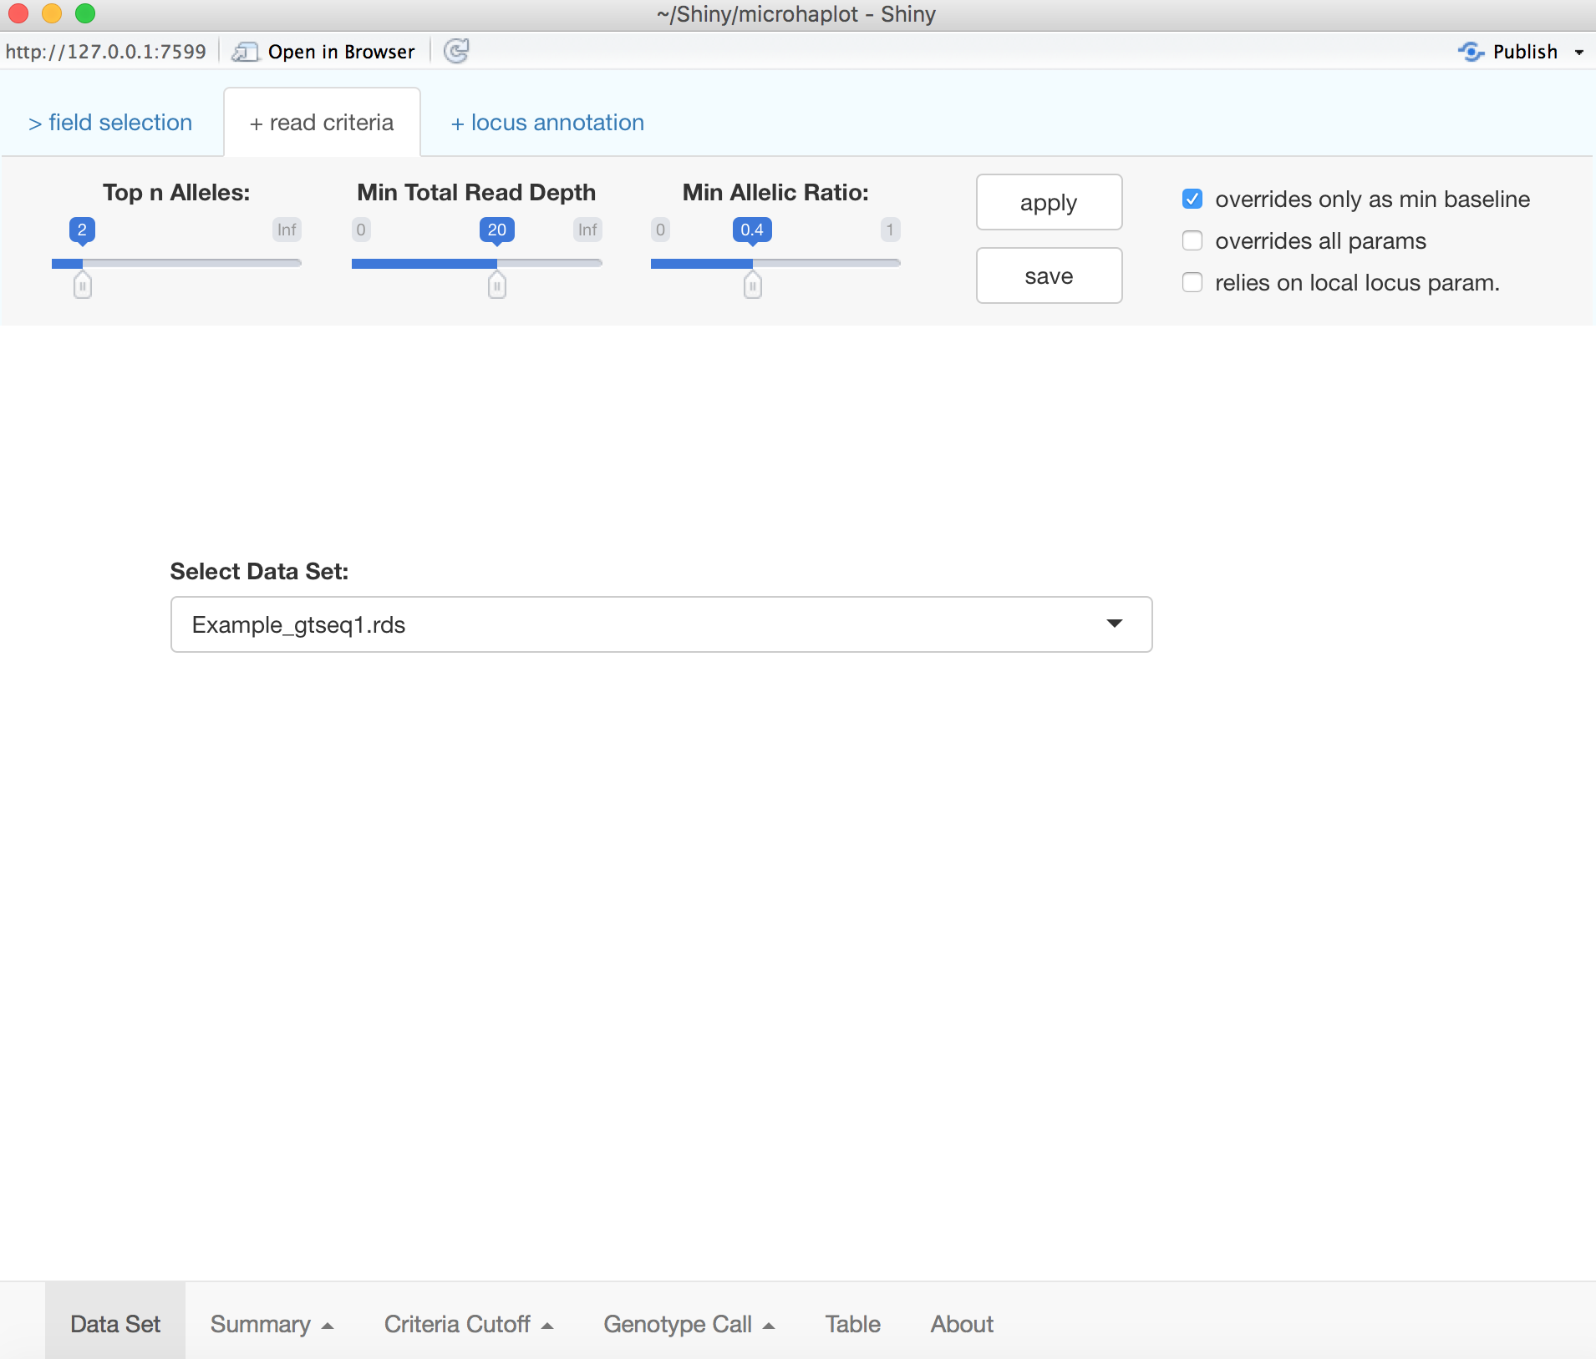

Slide 28
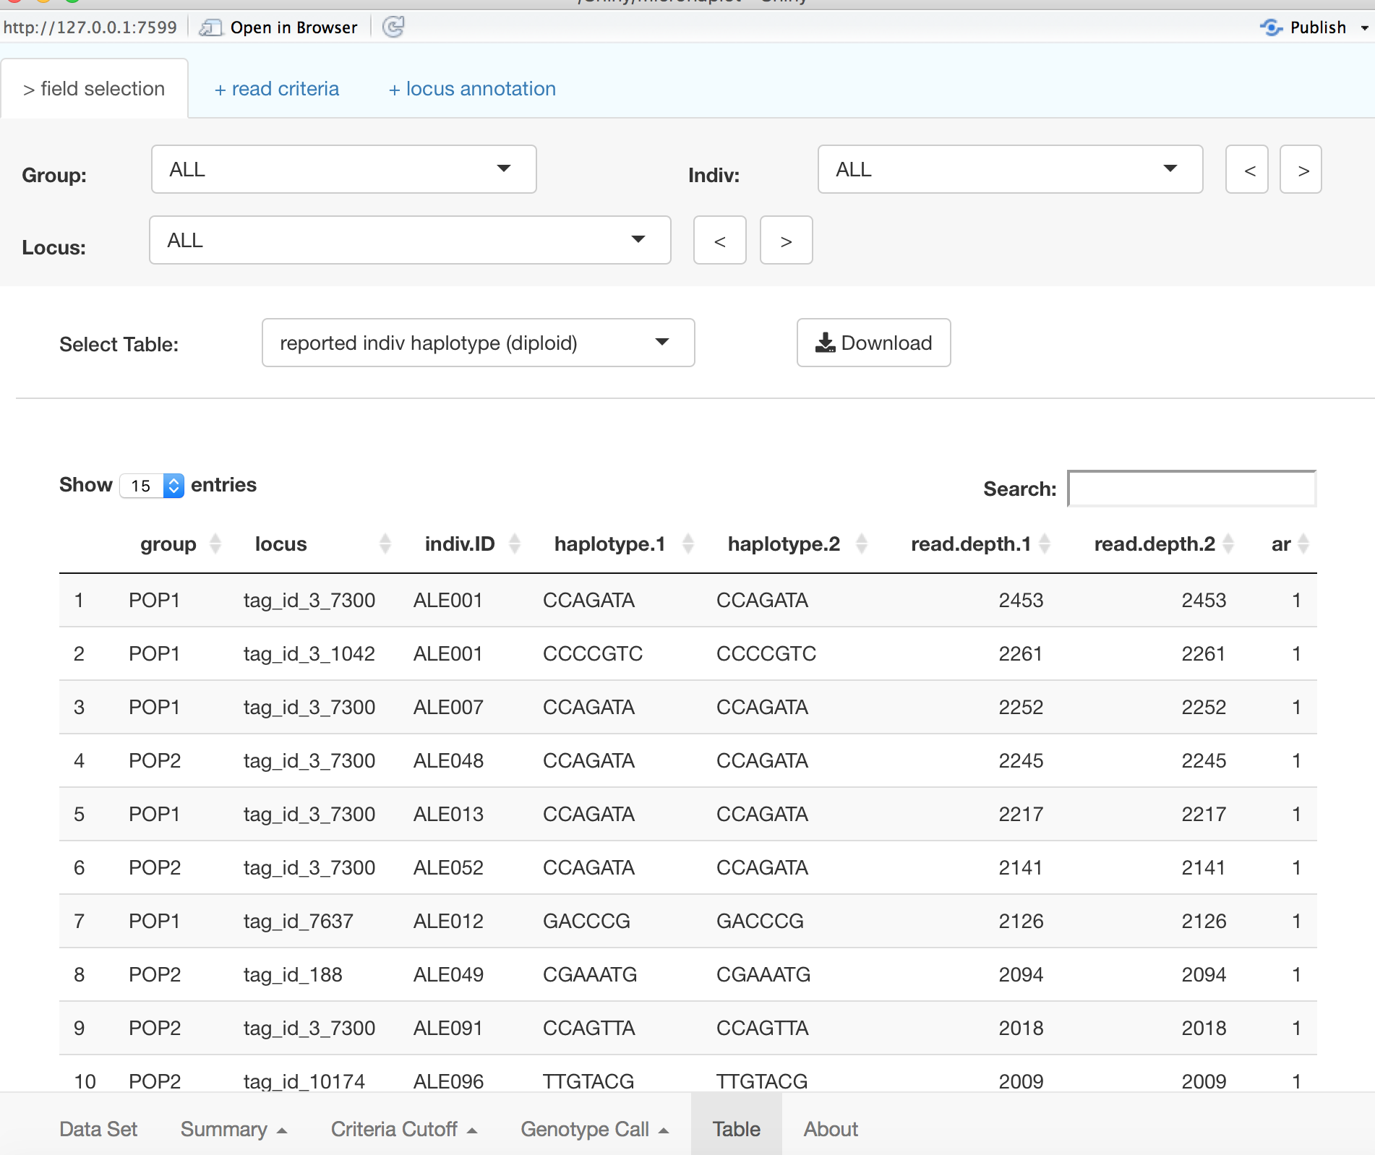

Slide 29
Other helpful resources
Baetscher et al., 2018 (useful for simulating parentage data from mhaps)
https://datadryad.org/resource/doi:10.5061/dryad.5863d?show=full
Baetscher et al., 2018 (useful Rmarkdown of how to analyze large scale data for parentage)
https://datadryad.org/handle/10255/dryad.205630
Simulations for parentage using mhaps
https://github.com/eriqande/CKMRsim

